Slide 1
Neural Networks: Computational Neuron
Lecture 4
Dr. Tehseen Zia

Slide 2
Topics
Representing Perceptron
Linearly and Nonlinearly Separable Problems
Implementing AND, OR with Perceptron
Limitation of Perceptron
Computational Neuron
Learning Computational Neuron

Slide 3
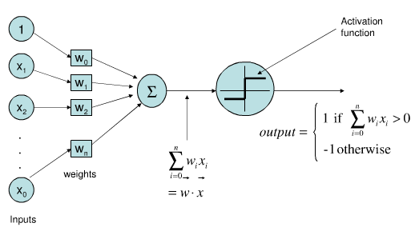
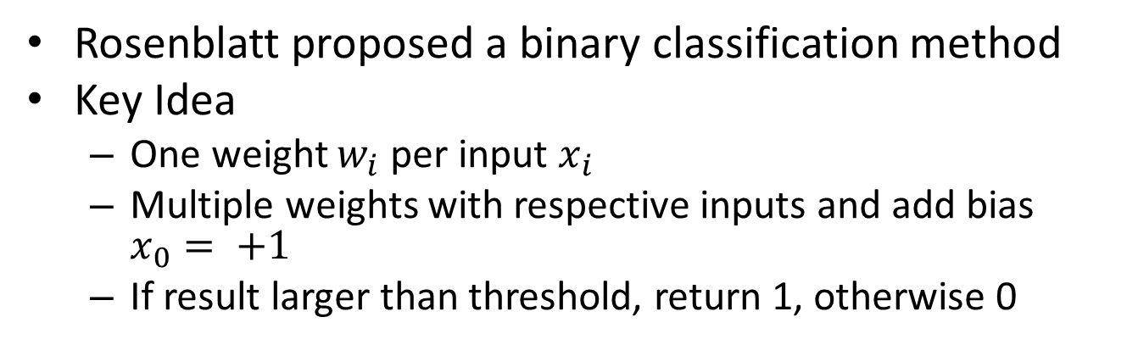
Perceptron
Rosenblatt proposed a binary classification method
Key Idea
One weight $w_{i}$ per input $x_{i}$
Multiple weights with respective inputs and add bias $x_{0}= +1$
If result larger than threshold, return 1, otherwise 0

Slide 4
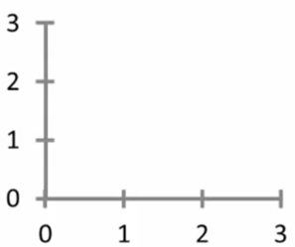






Perceptron Decision Boundary: Linear
Single input neuron
$$w_{1}$$
$$x_{1}$$
∑
$$\hat{y}$$
$$w_{1}=0.5$$
$$\hat{y}$$
$$x_{1}$$

Slide 5
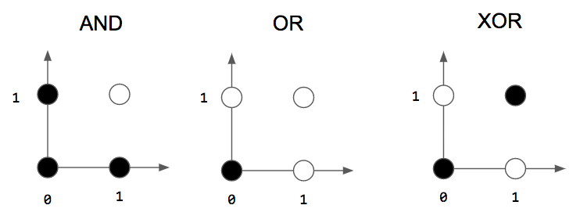
Linearly and Nonlinearly Separable Problem

Slide 6






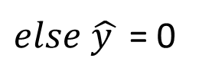

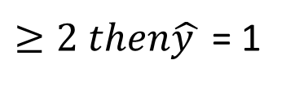
Implementing AND with Perceptron
$${x }_{1}$$
$${w }_{1}=1$$
$$\hat{y }$$
$${∑= w }_{1}{x }_{1}+{w }_{2}{x }_{2}$$
$$=2$$
$${x }_{2}$$
${w }_{2}=$ 1
$≥2 then\hat{y }$ = 1
$else \hat{y }$ = 0

Slide 7

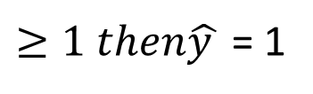
Implementing OR with Perceptron
$${x }_{1}$$
$${w }_{1}=1$$
$$\hat{y }$$
$${∑= w }_{1}{x }_{1}+{w }_{2}{x }_{2}$$
$$=1$$
$${x }_{2}$$
${w }_{2}=$ 1
$≥1 then\hat{y }$ = 1
$else \hat{y }$ = 0

Slide 8
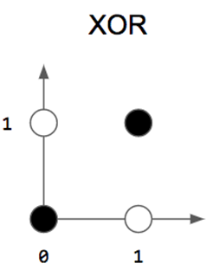
Implementing XOR with Perceptron

Slide 9
Implementing XOR with Perceptron

Slide 10
Implementing XOR with Perceptron
We cannot because XOR is nonlinearly separable

Slide 11
Implementing XOR with Multi-Perceptron
Perceptron # 2
Perceptron # 1

Slide 12
Nonlinearly Separable Problems and Multi-perceptron
Decision rule:
if ∑ of P1 < 0 -> black
elseif ∑ of P2 > 0 -> black
else white
Perceptron # 2
Perceptron # 1

Slide 13









Multi-perceptron Architecture
Perceptron # 1
$$w_{11}$$
$$x_{1}$$
∑
$$w_{11}$$
$$w_{12}$$
$$\hat{y}$$
∑
$$w_{21}$$
$$x_{2}$$
$$w_{22}$$
$$w_{21}$$
∑
Perceptron # 2
Perceptron # 3

Slide 14
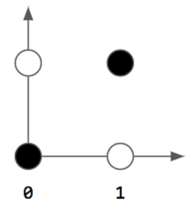
Multi-perceptron Architecture
Perceptron # 1
$$w_{11}$$
$$x_{1}$$
∑
$$w_{11}$$
$$w_{12}$$
$$\hat{y}$$
∑
$$w_{21}$$
$$x_{2}$$
$$w_{22}$$
$$w_{21}$$
∑
Perceptron # 2
Perceptron # 3

Slide 15

Nonlinearity is Important
Perceptron 1: ${w }_{11}{x }_{1}+{w }_{21}{x }_{2}$
Perceptron 2: ${w }_{12}{x }_{1}+{w }_{22}{x }_{2}$
Perceptron 3: ${w }_{11}({w }_{11}{x }_{1}+{w }_{21}{x }_{2})+{w }_{21}({w }_{12}{x }_{1}+{w }_{22}{x }_{2})$

Slide 16
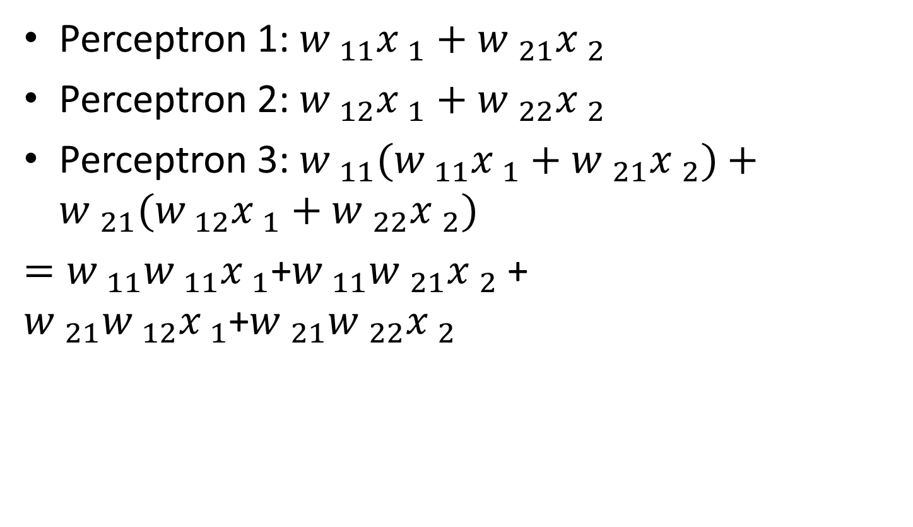
Nonlinearity is Important
Perceptron 1: ${w }_{11}{x }_{1}+{w }_{21}{x }_{2}$
Perceptron 2: ${w }_{12}{x }_{1}+{w }_{22}{x }_{2}$
Perceptron 3: ${w }_{11}({w }_{11}{x }_{1}+{w }_{21}{x }_{2})+{w }_{21}({w }_{12}{x }_{1}+{w }_{22}{x }_{2})$
$={w }_{11}{w }_{11}{x }_{1}$+${w }_{11}{w }_{21}{x }_{2}$ + ${w }_{21}{w }_{12}{x }_{1}$+${w }_{21}{w }_{22}{x }_{2}$

Slide 17
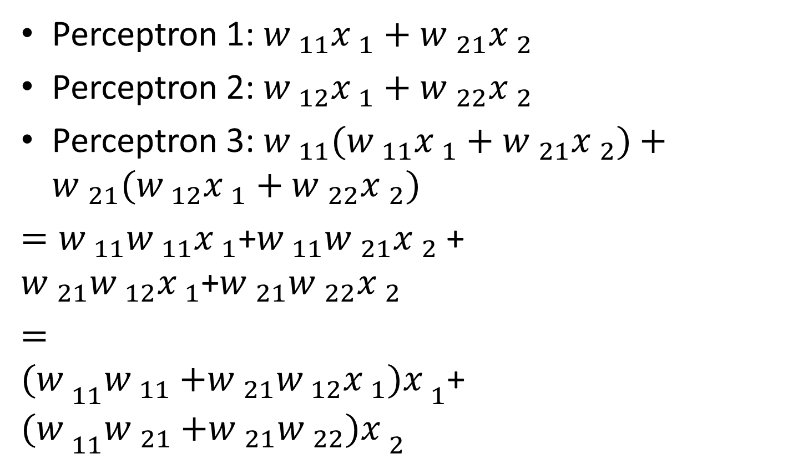
Nonlinearity is Important
Perceptron 1: ${w }_{11}{x }_{1}+{w }_{21}{x }_{2}$
Perceptron 2: ${w }_{12}{x }_{1}+{w }_{22}{x }_{2}$
Perceptron 3: ${w }_{11}({w }_{11}{x }_{1}+{w }_{21}{x }_{2})+{w }_{21}({w }_{12}{x }_{1}+{w }_{22}{x }_{2})$
$={w }_{11}{w }_{11}{x }_{1}$+${w }_{11}{w }_{21}{x }_{2}$ + ${w }_{21}{w }_{12}{x }_{1}$+${w }_{21}{w }_{22}{x }_{2}$
$={(w }_{11}{w }_{11}{+{w }_{21}{w }_{12}{x }_{1})x }_{1}$+${(w }_{11}{w }_{21}{+{w }_{21}{w }_{22})x }_{2}$

Slide 18
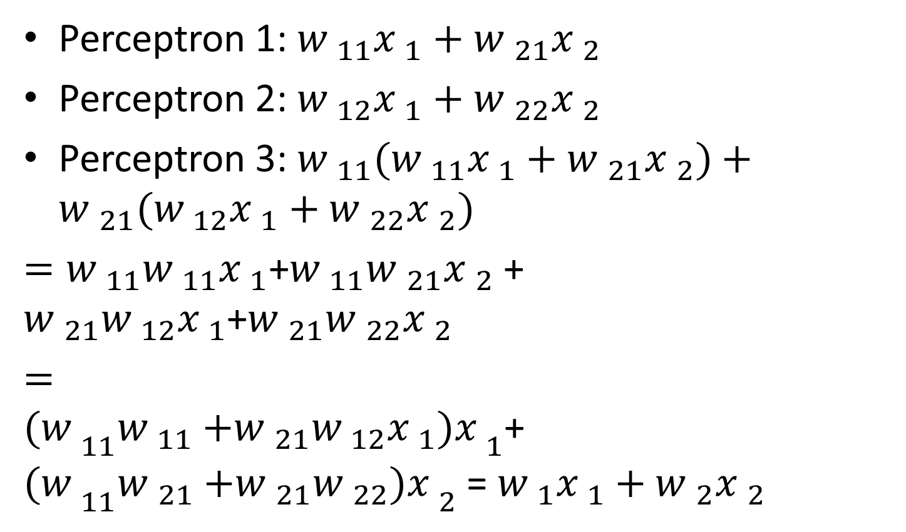
Nonlinearity is Important
Perceptron 1: ${w }_{11}{x }_{1}+{w }_{21}{x }_{2}$
Perceptron 2: ${w }_{12}{x }_{1}+{w }_{22}{x }_{2}$
Perceptron 3: ${w }_{11}({w }_{11}{x }_{1}+{w }_{21}{x }_{2})+{w }_{21}({w }_{12}{x }_{1}+{w }_{22}{x }_{2})$
$={w }_{11}{w }_{11}{x }_{1}$+${w }_{11}{w }_{21}{x }_{2}$ + ${w }_{21}{w }_{12}{x }_{1}$+${w }_{21}{w }_{22}{x }_{2}$
$={(w }_{11}{w }_{11}{+{w }_{21}{w }_{12}{x }_{1})x }_{1}$+${(w }_{11}{w }_{21}{+{w }_{21}{w }_{22})x }_{2}$ = ${w }_{1}{x }_{1}+{w }_{2}{x }_{2}$
Linear function

Slide 19


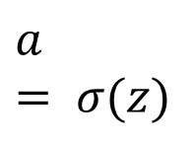


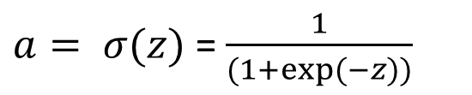
Computational Neuron
$${x }_{1}$$
$${w }_{1}$$
$$a=\hat{y }$$
$${z= w }_{1}{x }_{1}+{w }_{2}{x }_{2}$$
$$a= σ(z)$$
$${x }_{2}$$
$${w }_{2}$$
$a= σ(z)$ = $\frac{1}{(1+exp⁡(−z))}$

Slide 20
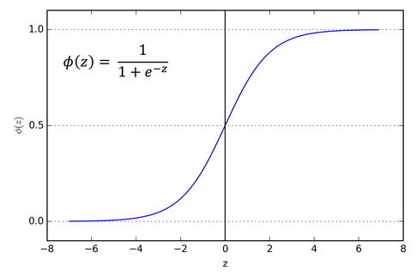
Computational Neuron
$a= σ(z)$ = $\frac{1}{(1+exp⁡(−z))}$

Slide 21




Interpretation
$$a= σ(z)$$
$$a=p\left(y=1\right| x, w)$$
Decision rule:
$$\hat{y}=1, ifa≥0.5$$
$$\hat{y}=0, ifa<0.5$$

Slide 22
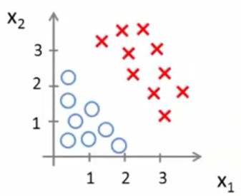



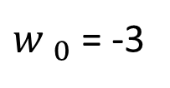
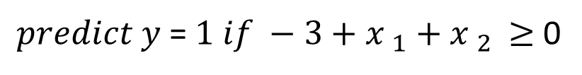
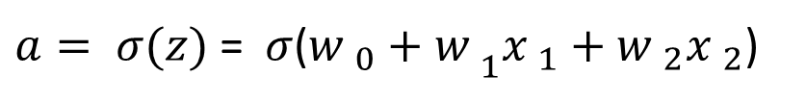
Decision Boundary
$${z={w }_{0}+w }_{1}{x }_{1}+{w }_{2}{x }_{2}$$
$a= σ(z)$ = $σ$(${{w }_{0}+w }_{1}{x }_{1}+{w }_{2}{x }_{2}$)
Suppose
${w }_{0}$ = -3
$${w }_{1}=1$$
$${w }_{2}=1$$
$predict y$= $1 if −3+{x }_{1}+$ ${x }_{2 }≥$ 0

Slide 23
Decision Boundary
$${z={w }_{0}+w }_{1}{x }_{1}+{w }_{2}{x }_{2}$$
$a= σ(z)$ = $σ$(${{w }_{0}+w }_{1}{x }_{1}+{w }_{2}{x }_{2}$)
Suppose
${w }_{0}$ = -3
$${w }_{1}=1$$
$${w }_{2}=1$$
$predict y$= $1 if −3+{x }_{1}+$ ${x }_{2 }≥$ 0

Slide 24
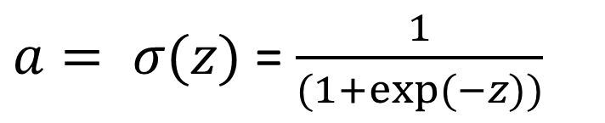
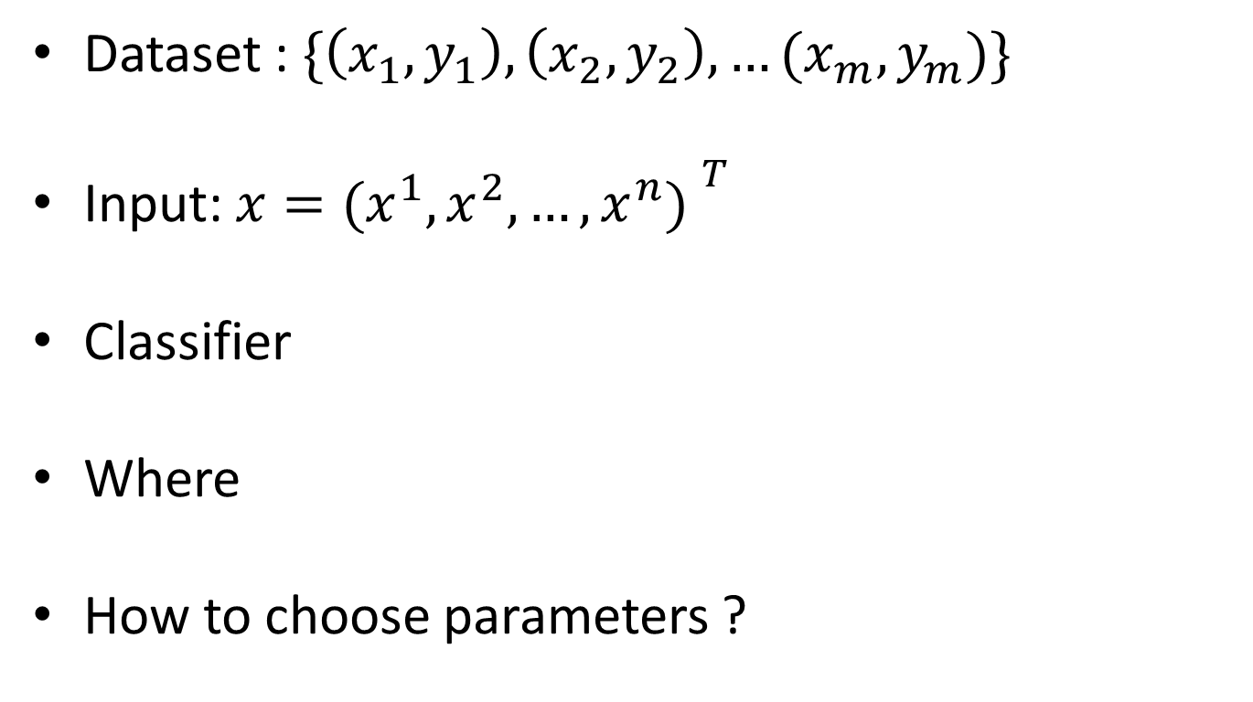
Learning Task
Dataset : $\{\left(x_{1},y_{1}\right),\left(x_{2},y_{2}\right), …(x_{m},y_{m})\}$
Input: $x={{(x}^{1},x^{2}, …,x^{n}) }^{T}$
Classifier
Where
How to choose parameters ?
$a= σ(z)$ = $\frac{1}{(1+exp⁡(−z))}$
$${z= w }_{1}x^{1}+{w }_{2}x^{2}+…+{w }_{n}x^{n}$$

Slide 25
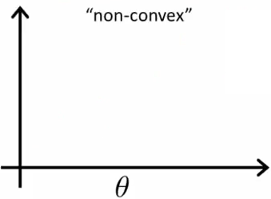
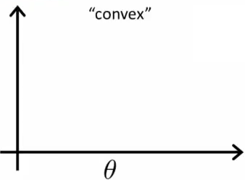
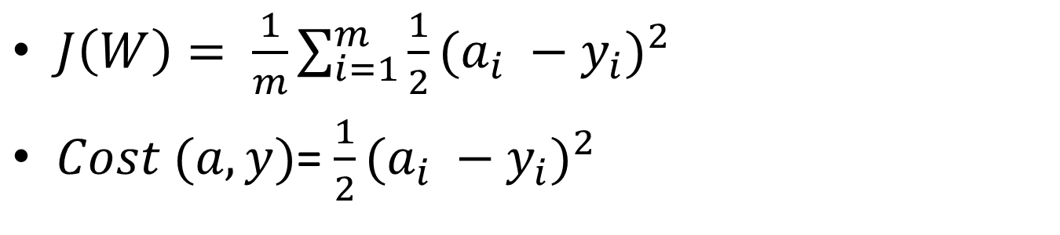
Cost Function
$J\left(W\right)= \frac{1}{m}\sum_{i=1}^{m}{{\frac{1}{2}(a_{i} −y_{i})}^{2}}$
$Cost (a,y)$= ${\frac{1}{2}(a_{i} −y_{i})}^{2}$

Slide 26
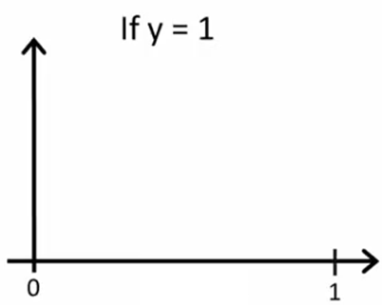
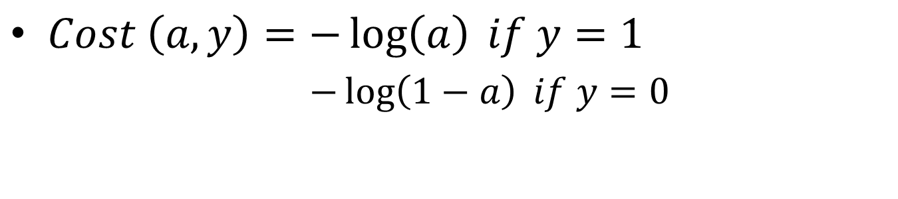

Cost Function
$Cost \left(a,y\right)=−\log\left(a\right) if y=1$
$−\log\left(1−a\right) if y=0$
Cost = 0 if y = 1, a = 1
But as a -> 0
Cost -> ∞
$$a$$

Slide 27
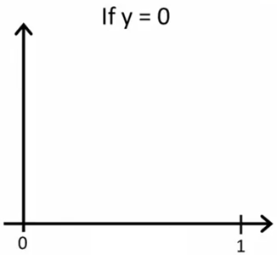
Cost Function
$Cost \left(a,y\right)=−\log\left(a\right) if y=1$
$−\log\left(1−a\right) if y=0$
Cost = 0 if y = 0, a = 0
But as a -> 1
Cost -> ∞
$$a$$

Slide 28
Cost Function
$Cost \left(a,y\right)=−\log\left(a\right) if y=1$
$−\log\left(1−a\right) if y=0$
Cost = 0 if y = 0, a = 0
But as a -> 1
Cost -> ∞
$$a$$

Slide 29
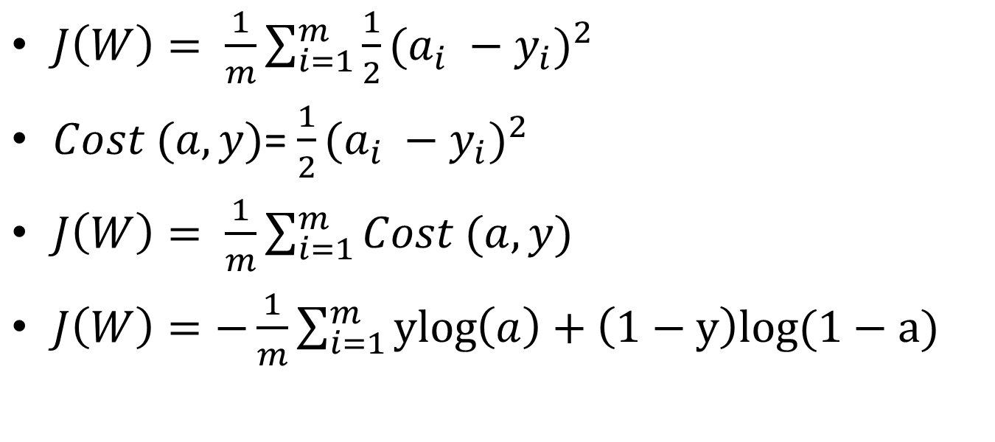
Cost Function
$J\left(W\right)= \frac{1}{m}\sum_{i=1}^{m}{{\frac{1}{2}(a_{i} −y_{i})}^{2}}$
$Cost (a,y)$= ${\frac{1}{2}(a_{i} −y_{i})}^{2}$
$J\left(W\right)= \frac{1}{m}\sum_{i=1}^{m}{Cost (a,y)}$
$J\left(W\right)=−\frac{1}{m}\sum_{i=1}^{m}{\operatorname{ylog}\left(a\right)}+\left(1−y\right)log(1−a)$

Slide 30

Cost Function
$J\left(W\right)= \frac{1}{m}\sum_{i=1}^{m}{{\frac{1}{2}(a_{i} −y_{i})}^{2}}$
$Cost (a,y)$= ${\frac{1}{2}(a_{i} −y_{i})}^{2}$
$J\left(W\right)= \frac{1}{m}\sum_{i=1}^{m}{Cost (a,y)}$
$J\left(W\right)=−\frac{1}{m}\sum_{i=1}^{m}{\operatorname{ylog}\left(a\right)}+\left(1−y\right)log(1−a)$
To fit parameters w:
$$\min_{W}J\left(W\right)$$

Slide 31

Learning Parameters: Gradient Descent Algorithm
$J\left(W\right)=−\frac{1}{m}\sum_{i=1}^{m}{\operatorname{ylog}\left(a\right)}+\left(1−y\right)log\left(1−a\right)$
$Repeat\{$
$$W_{i}←W_{i}+∆W_{i}$$
$∆W_{i}=ƞ(y −a)$ $x_{i}$
$\}$

Slide 32
Next Lecture
Neural Networks
Solving XOR with Neural Networks

Slide 33
Paper Reading [Only for Students that passed Adv. Topics in AI]
Reading and understanding Image Classification State-of-art:
ResNet Network
Inception-ResNet Network
Squeeze-and-excitation networks

Slide 34
Reading References [Only for Students that passed Adv. Topics in AI]
[1] Szegedy, C., Ioffe, S., Vanhoucke, V. and Alemi, A.A., 2017, February. Inception-v4, inception-resnet and the impact of residual connections on learning. In AAAI (Vol. 4, p. 12).
[2] Hu, J., Shen, L. and Sun, G., 2017. Squeeze- and-excitation networks. arXiv preprint arXiv:1709.01507, 7.

